Slide 1
Capstone Project – Battle of Neighborhood IBM – Applied Data Science Project
Indian Restaurant in San Francisco Bay Area
Mayuree Deshmukh
(18th October 2019)

Slide 2
Business Problem
Recommend an Entrepreneur, a preferred set of locations for opening an Indian Restaurant in San Francisco Bay Area.
Objective: To analyze and select the best locations in San Francisco Bay Area to open new Indian Restaurant.
Business Question: Considering the competitive world of business and diverse culture of State California, which are the most preferred locations for opening an Indian Restaurant in San Francisco bay Area?

Slide 3
Data
List of Neighborhood in San Francisco Bay Area
Latitude and Longitude coordinates of those Neighborhood
Venue data related to the Indian Restaurant.
Sources of Data
Wikipedia page for Cities and towns in San Francisco Bay Area (https://en.wikipedia.org/wiki/List_of_cities_and_towns_in_the_San_Francisco_Bay_Area)
Geocoder package for Latitude and Longitude coordinates
Foursquare API for Venue Data

Slide 4
Methodology
Web Scraping: List of Neighborhoods in San Francisco from Wikipedia.
Getting Latitude and Longitude data of neighborhoods via Geocoder python package.
Using Foursquare API, to get venue data related to the neighborhood.
Data cleaning and data Wrangling with the help of python package pandas.
Machine Learning K-Means Clustering technique, to cluster the neighbors with same venue category.
Data Visualization with the help of python package Folium.

Slide 5
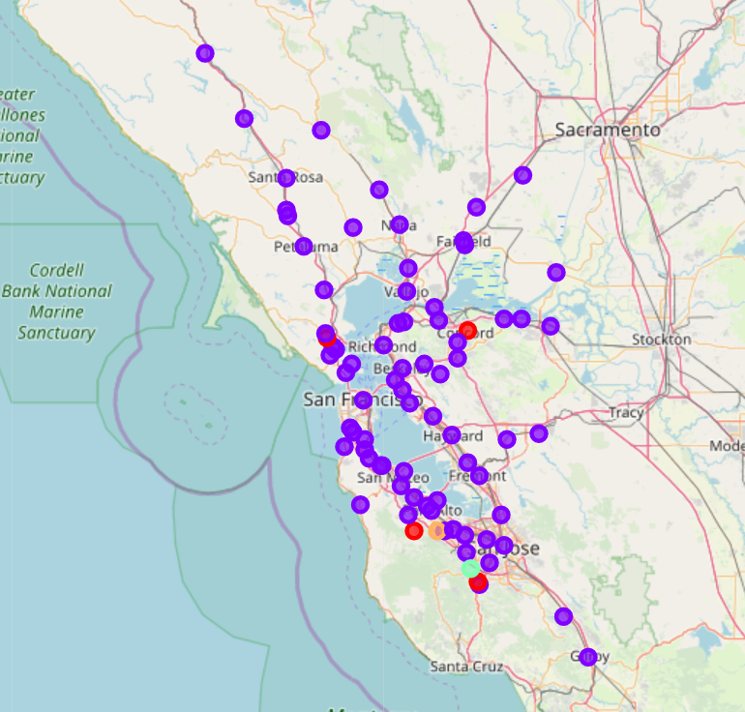
Results
Categorized Venues into 5 Clusters based on top 10 common venues
Cluster 0 and 1: Many Restaurants, many public places, tough competition.
Not preferred areas.

Slide 6
Discussion
Cluster 2: (Place: San Mateo)
2 Restaurants, 1 Snack Center
Includes public areas and utility stores
Cluster 3: (Place: Saratoga)
Only 2 Restaurants
Includes public areas and utility stores
Cluster 4: (Place: Los Altos Hills)
Only 1 Restaurants
Includes public areas and utility stores

Slide 7
Conclusion
Project purpose: Find preferred location for opening Indian Restaurant
Answer to Business Question: Clusters 2, 3 and 4 are most preferred locations.
Locations: San Mateo, Saratoga, Los Altos Hills.
Findings of this projects will help the relevant Entrepreneurs to capitalize the opportunities on high potential locations avoiding the overcrowded areas in their decision to open an Indian Restaurant in San Francisco Bay Area.

Slide 8


